Slide 1


The Learning and Academic Resource Center (LARC) was built in Summer 2018 and brought together the primary peer-academic support services on campus. The LARC is located in the University Library in a bustling Information Commons area that now houses other student support services, such as Advising, TRIO programs, and our Transfer Center.
3 Peer-Staffed Academic Support Programs
(funded by AS fees and lottery funds)
Tutorial Program
Supplemental Instruction Program
Writing Center

Slide 2
2019-2020
Tutorial Program Snapshot
50
supported courses
788
students served
998
tutoring appts.

Slide 3

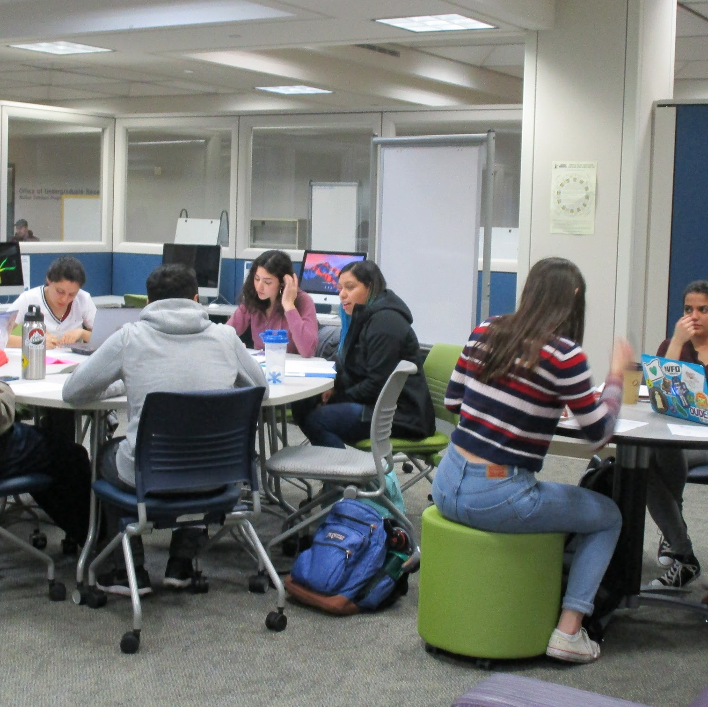
Supplemental Instruction (SI)
Supplemental Instruction (SI) is an internationally recognized academic assistance program that provides weekly, peer-led group study sessions for students taking historically difficult courses. SI sessions are regularly scheduled, informal review sessions where students learn how to integrate course content and study skills while working together. The sessions are facilitated by SI Leaders, students who have previously done well in the course and who attend all class lectures, take notes, and act as model students.

Slide 4
2019-2020
Supplemental Instruction Snapshot
99
supported courses
1,961 students served
10,211
Session Visits

Slide 5
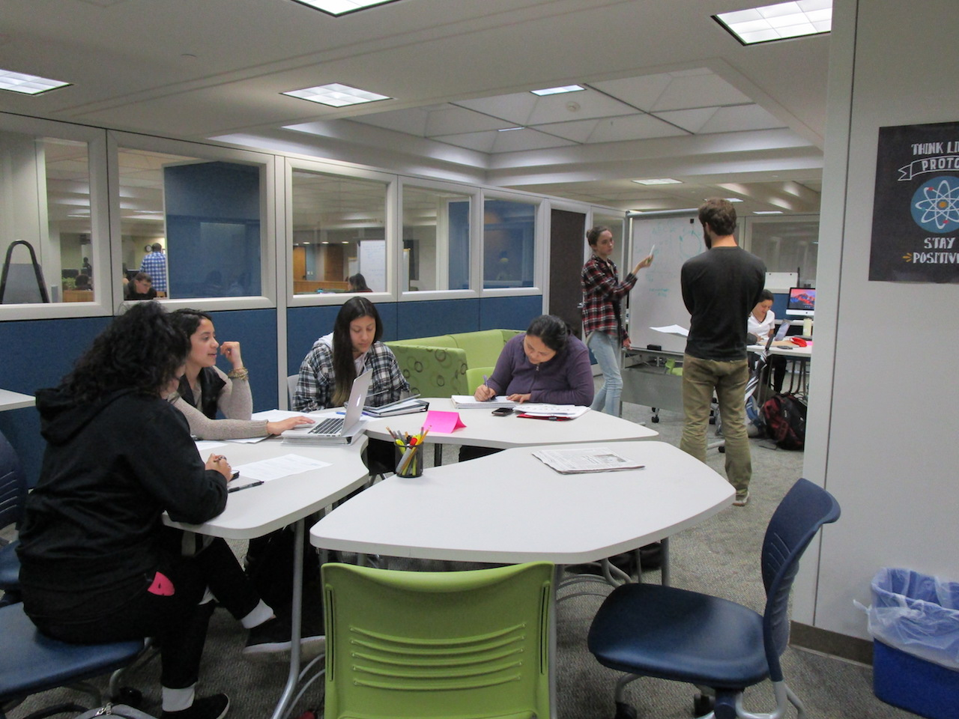
Stretch Math Learning Communities (LC)
Stretch Math Learning Communities is a pilot program in collaboration with the Math department. Learning communities support year-long stretch math courses. Like SI Leaders, Learning Community Mentors (LCMs) share similar weekly duties. Unlike SI, however, LCMs host one 2-hour session each week, usually on Friday, and session attendance is mandatory.

Slide 6
Stretch Math Learning Communities (LC)
Why a new model? Why a Pilot Program?
In response to EO 1100 and GI 2025
Math Department wanted guaranteed attendance and homework help
Emphasis on a math community
High-risk students, Category 3 and 4

Slide 7
Key differences between SI Sessions and Learning Communities
Supplemental Instruction Sessions | Learning Communities
Optional and Anonymous | Mandatory and Attendance is graded
1 hour sessions, multiple times per week, scheduled around students’ availability | 2 hours session once per week, scheduled by the department
Peer Educator is called an SI Leader | Peer Educator is called a Learning Community Mentor
Sessions primarily focus on reviewing key course concepts and test prep; no homework help. | Session time includes homework help
 | Requires a degree of classroom management and more emphasis on guidelines for community behavior

Slide 8
Stretch Math Learning Communities (LCs)
Some Stats:
20 sections supported in 2020-21 (13 of those sections are Math 165/Statistics)
16 Learning Community Mentors, some supporting 2 sections
Attendance is mandatory, but session attendance is consistently around 75%

Slide 9
Stretch Math Learning Communities (LCs)
How Students feel about the LCs:
70% found their Learning Community Mentor helpful, created engaging materials
84% felt that the LCM created a positive online learning environment
48% felt that the LCM helped them develop better online learning strategies.
72% stated that they would attend the sessions even if they were optional, and not mandatory

Slide 10
It gave me a sense of community...It helped take my stress away!
Sierra made class fun which is hard at 7pm on Wednesday because by then I just want to sleep. I also made friends because she made us talk to each other.
Victoria has amazing advising skills and she was very helpful with learning how to do math problems as well as giving advice for college in general. She always makes sure that we are aware of all of the resources that SSU offers and she has helped me feel more comfortable with online classes.
The LCM sessions are so helpful and fun to attend because we work collaboratively and Phanny makes the material easier to understand.

Slide 11
Supporting Stretch Math Faculty
& Evaluating the Pilot Program
Year 1: Attended Dept Mtgs, Created special faculty resource guides, ongoing Google reflection form for faculty to communicate with us, faculty feedback surveys, weekly reflections from LCMs, end of term student surveys. This was all in addition to our regular training, professional development and support of the peer educators.
Year 2 and 3: All of the above, although we abandoned the faculty Google reflection forms due to low participation. Reinforced the importance of collaboration and communication between faculty, LCMs and we started an SI/LC Advisor program to support new peer educators.
Advisor Program

Slide 12
Things We’ve Learned
The community aspect has been key. If the LCM and the participants create a good bond, we often find that participants apply to be future peer educators.
The best LCMs are students on a teaching track.
LCMs have a heavier load than SI Leaders because of the number of students, and it requires a higher level of responsibility and maturity.
The collaborative relationship between faculty and LCM is crucial. They have to be very clear about their role with the students and sometimes the faculty, as they can be mistaken as TAs.
Students don’t want to stay the full two-hours so homework help time becomes optional
It has been a challenging model to sustain fiscally and operationally.

Slide 13
Where we’re at now...
We are at the end of the pilot program AS funding has decreased dramatically and will likely continue to decrease unless our enrollment numbers get better.
We will be seeking additional funding, but we’ll also be exploring alternative models and adaptations to the Learning Communities.
Other campuses might consider this type of model if they are already supporting stretch math courses with SI and not seeing attendance.

Slide 14
The Learning and Academic Resource Center
Operating Remotely Fall 2020-Spring 2021
For more information about the LARC please contact:
Loriann Negri, LARC Director loriann.negri@sonoma.edu
Cora Orme, Tutorial & SI Coordinator orme@sonoma. edu

Slide 15



Follow us!
@ssularc
larc.sonoma.edu
Notes:
ANY QUESTIONS?

